Slide 1
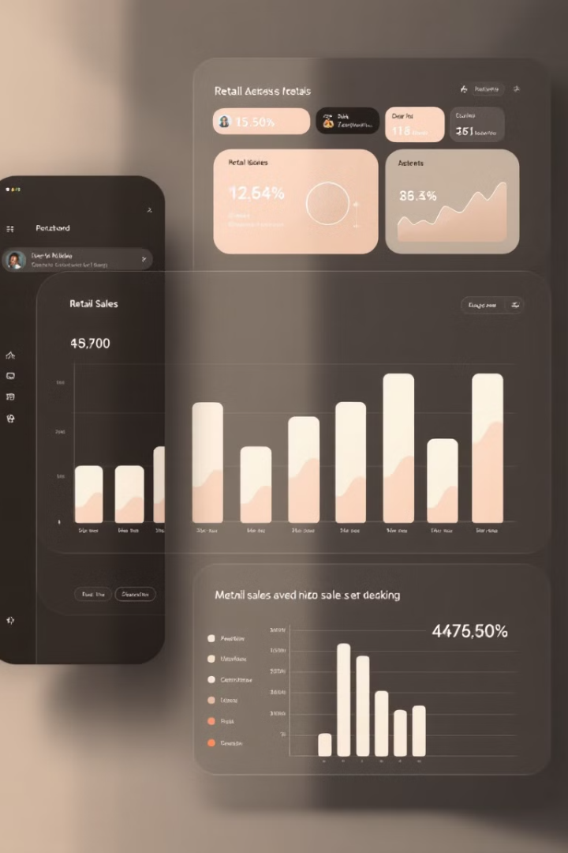

RFM Segmentation & EDA on Superstore Sales Data
This project performs RFM Segmentation and Exploratory Data Analysis (EDA) on a Superstore Sales dataset using MySQL. The goal is to uncover key business insights, such as sales recency, frequency, monetary trends, profitability, customer segmentation, and regional performance.
by Sushanto Roy

Slide 2
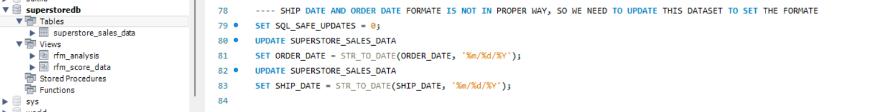
Data Preparation Process
Dataset Loading
1
Loaded the superstore_sales_data dataset into MySQL database environment for analysis. The dataset contains comprehensive sales information including customer details, product information, and transaction records.
2
Data Exploration
3
Date Format Conversion
Explored the dataset structure using SQL queries to ensure proper formatting and understand available fields. This helped identify key attributes for analysis and potential data quality issues.
Converted order date and ship date columns into the correct date format using STR_TO_DATE() function to enable proper temporal analysis and calculation of recency metrics.

Slide 3





Exploratory Data Analysis Approach
Identify Top-Selling Products
Aggregated total sales by product to discover which items generate the most revenue. This helps in understanding product performance and identifying potential focus areas for inventory management.
Determine Most Profitable Products
Calculated total profit by product to identify which items contribute most to the bottom line. This analysis reveals products with high margin potential versus high volume but low margin items.
Analyze Category Performance
Examined sales and profit trends by product categories to understand which segments drive business growth. This provides strategic insights for category management and expansion decisions.
Examine Customer Behavior
Analyzed customer purchase frequency and total spending to understand buying patterns and identify high-value customers for personalized marketing.

Slide 4
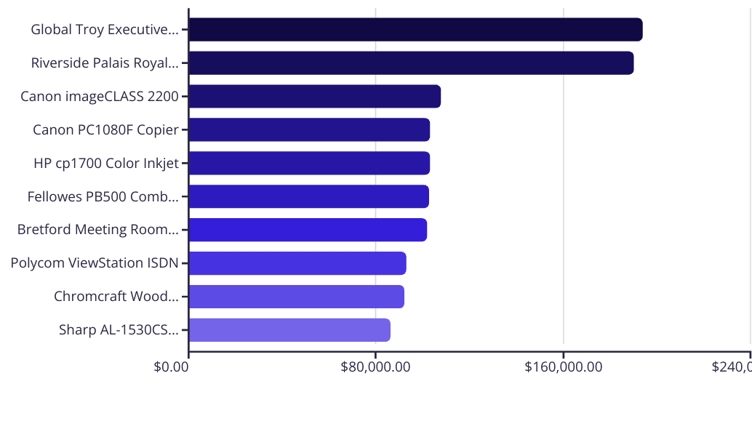
Top 10 Products by Sales
SQL Query:
SELECT PRODUCT_NAME,
SUM(SALES) AS TOTAL_SALES
FROM SUPERSTORE_SALES_DATA
GROUP BY PRODUCT_NAME
ORDER BY TOTAL_SALES DESC
LIMIT 10;
The analysis reveals that high-ticket office furniture and advanced electronics dominate the top-selling products, with the Global Troy Executive Leather Tilter chair leading at $194,026 in sales.

Slide 5
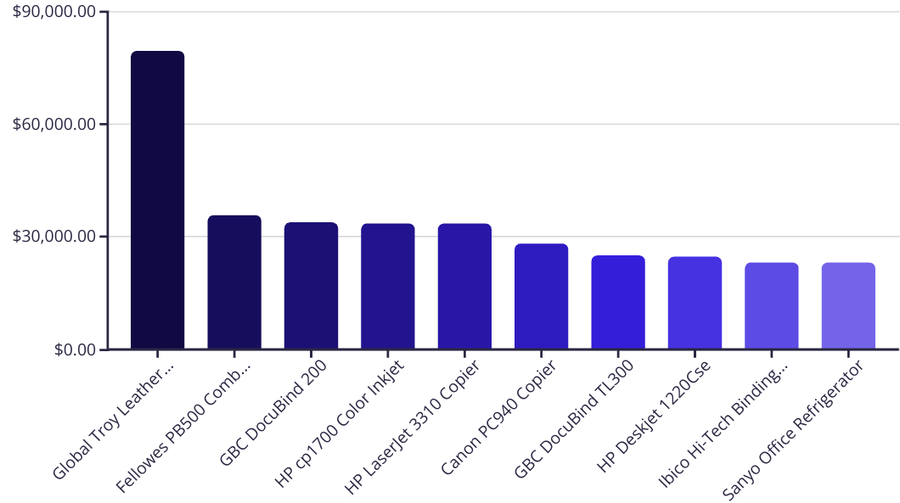
Top 10 Most Profitable Products
SQL Query:
SELECT Product_Name, SUM(Profit) AS Total_profit
FROM SUPERSTORE_SALES_DATA
GROUP BY Product_Name
ORDER BY Total_profit DESC
LIMIT 10;
The Global Troy Executive Leather chair stands out with $79,509 in profit, more than double the next most profitable item. Office equipment like binding machines and printers dominate the list, indicating these product categories maintain strong profit margins.

Slide 6




RFM Calculation Methodology
Recency
Frequency
Monetary Value
Calculated days since the last purchase for each customer using the DATEDIFF function between the maximum order date in the dataset and each customer's most recent order date.
Counted total distinct purchases made by each customer using COUNT(DISTINCT ORDER_ID) to understand how often customers engage with the business.
Summed total revenue generated by each customer using SUM(SALES) to determine their lifetime value and spending power within the business ecosystem.

Slide 7
RFM Scoring System
Map to Segments
Create Combined Score
Used SQL CASE statements to map RFM score combinations to meaningful customer segments that represent different relationship stages and business value.
Assign Individual Scores
Rank Customers
Generated a combined RFM score by concatenating individual dimension scores (e.g., 444 for best customers, 111 for least engaged customers).
Ranked customers into 4 segments for Recency, Frequency, and Monetary metrics using NTILE(4) SQL function. This creates quartiles for each dimension, allowing for consistent comparison across different metrics.
Assigned R, F, and M scores ranging from 1 (low value to business) to 4 (high value to business) for each dimension. For Recency, a lower number of days since last purchase results in a higher score.

Slide 8
Category Performance Analysis
Technology
Furniture
Office Supplies
Generates the highest total sales at $3,507,113.42, but delivers just $688,056.59 in profit, indicating lower margin products. Technology products may benefit from bundling strategies or value-added services to improve profitability.
Ranks second in sales with $2,997,619.10 but leads in profitability with $1,216,151.00. This category offers the best return on investment with high margins, suggesting potential for expansion and premium positioning.
The smallest category with $2,193,243.65 in sales and $440,488.39 in profit. Though lower in volume, these products may serve as entry points for customer relationships and complement higher-value purchases.
SQL Query:
SELECT PRODUCT_CATEGORY, SUM(Sales) AS TOTAL_SALES, SUM(Profit) AS TOTAL_PROFIT
FROM SUPERSTORE_SALES_DATA
GROUP BY PRODUCT_CATEGORY
ORDER BY TOTAL_SALES DESC;
40.5%
19.6%
20.1%
Furniture Profit Margin
Technology Profit Margin
Office Supplies Margin
Highest margin category
Lowest margin category
Middle performer

Slide 9




RFM Segmentation Implementation
RFM Score Combination
1
Creating unique segments
2
R, F, M Scoring
Using NTILE(4) for quartiles
3
RFM Value Calculation
Recency, Frequency, Monetary
4
Customer Purchase Data
Transaction history
The implementation process begins with collecting customer purchase data and calculating the raw RFM values. SQL's NTILE function divides customers into quartiles for each dimension, generating scores from 1-4. These are combined into an RFM score combination like "444" for the most valuable customers.
SQL Query:
CREATE OR REPLACE VIEW RFM_SCORE_DATA AS
WITH RFM_SEGMENTATION AS
(SELECT CUSTOMER_NAME,
datediff((SELECT MAX(ORDER_DATE) FROM SUPERSTORE_SALES_DATA), MAX(ORDER_DATE)) AS RECENCY_VALUE,
COUNT(DISTINCT ORDER_ID) AS FREQUENCY_VALUE,
ROUND(SUM(SALES),0) AS MONETARY_VALUE
FROM SUPERSTORE_SALES_DATA
GROUP BY CUSTOMER_NAME),
RFM_SCORE AS
(SELECT RFM.*, NTILE(4) OVER (ORDER BY RECENCY_VALUE DESC) AS R_SCORE,
NTILE(4) OVER (ORDER BY FREQUENCY_VALUE ASC) AS F_SCORE,
NTILE(4) OVER (ORDER BY MONETARY_VALUE ASC) AS M_SCORE
FROM RFM_SEGMENTATION AS RFM)
SELECT R.CUSTOMER_NAME, R.RECENCY_VALUE, R_SCORE, R.FREQUENCY_VALUE, F_SCORE,
R.MONETARY_VALUE, M_SCORE, (R_SCORE + F_SCORE + M_SCORE) AS TOTAL_RFM_SCORE,
CONCAT_WS('', R_SCORE, F_SCORE, M_SCORE) AS RFM_SCORE_COMBINATION
FROM RFM_SCORE AS R;

Slide 10





Customer Segment Analysis & Recommendations
Loyal Customers (424)
Churned Customers (613)
High-value customers with average spend of $8,430. These are the bedrock of the business, providing consistent revenue. Implement loyalty rewards, early access to new products, and VIP services to maintain their engagement and increase their lifetime value.
Largest segment with low average spend of $496. These customers haven't purchased recently and require targeted re-engagement campaigns. Consider win-back promotions with special discounts or personalized communications highlighting new products that match their previous interests.
2
1
Slipping Away Customers (337)
3
High-value customers at risk with average spend of $7,016. These customers represent significant revenue that could be lost. Prioritize immediate retention efforts with personalized outreach, loyalty incentives, and focused customer service to address any potential issues.
New Customers (20)
5
Smallest segment with low average spend of $180. These recent acquisitions need nurturing to develop purchasing habits. Focus on onboarding communications, educational content about product value, and entry-level promotions to encourage repeat purchases.
4
Potential Churners (328)
Moderate spenders ($1,020) showing declining engagement. Proactive intervention is needed to prevent these customers from fully churning. Implement satisfaction surveys, targeted offers based on past purchases, and engagement campaigns to rebuild connection.
SQL Query:
SELECT
CUSTOMER_SEGMENT,
COUNT(*) AS NUMBER_OF_CUSTOMERS,
ROUND(AVG(MONETARY_VALUE),0) AS AVERAGE_MONETARY_VALUE
FROM RFM_ANALYSIS
GROUP BY CUSTOMER_SEGMENT;
The analysis reveals significant opportunities to improve customer retention and increase revenue through targeted marketing strategies tailored to each segment's characteristics and value potential.

